Slide 1
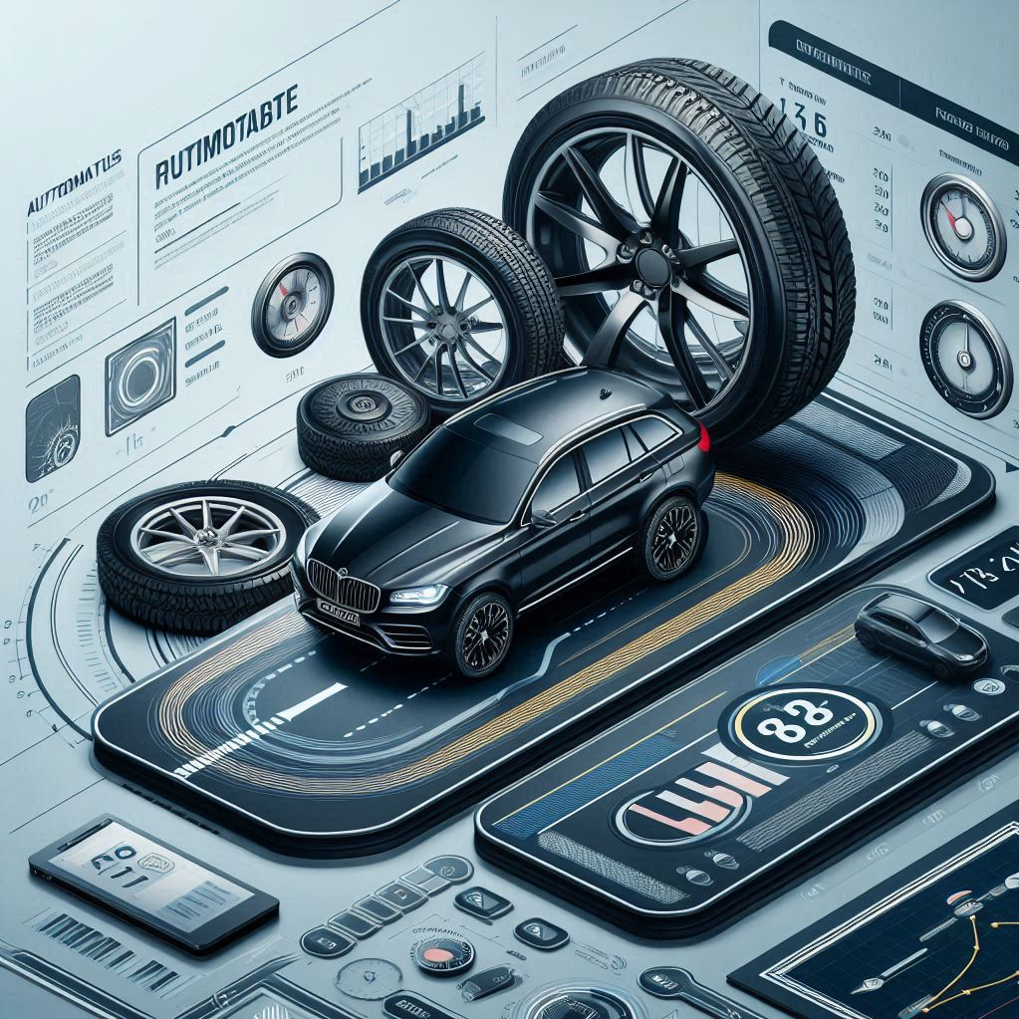
IMPACT OF CAR FEATURES ON PRICE AND PROFITABILITY
Shreya Gunjal​

Slide 2

Project description
The automotive industry has undergone significant transformation in recent decades, driven by advancements in fuel efficiency, sustainability initiatives, and cutting-edge technology. As competition among manufacturers intensifies and consumer preferences shift, understanding the key factors that influence car buying decisions has become crucial for success.
Given this backdrop, the task at hand for a Data Analyst is to determine how a car manufacturer can optimize pricing and product development to maximize profitability while catering to consumer demand. This entails analyzing the interplay between a car’s features, market segments, and pricing, and pinpointing the most sought-after and profitable attributes.
By strategically utilizing data analysis techniques such as regression analysis and market segmentation, the manufacturer can create a pricing strategy that harmonizes consumer demand with profitability.
Additionally, pinpointing key product features to focus on in future developments will help enhance market competitiveness and drive long-term profitability. This strategic approach ensures the manufacturer remains agile and responsive to market trends, ultimately securing a stronger foothold in the industry.

Slide 3
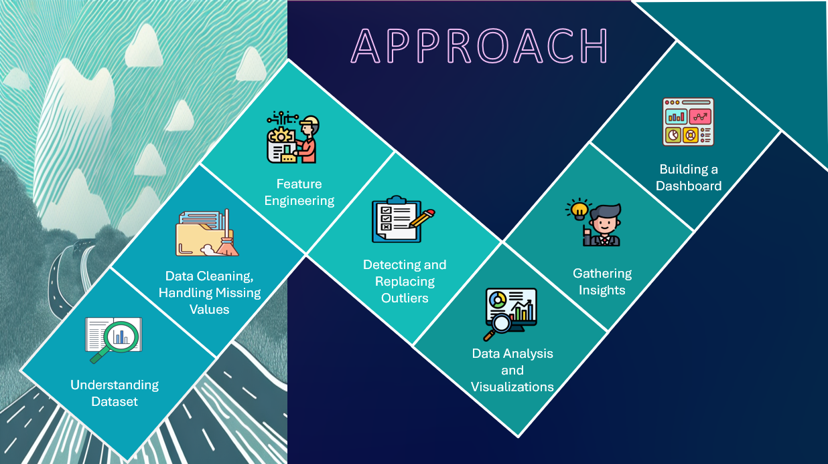

Slide 4
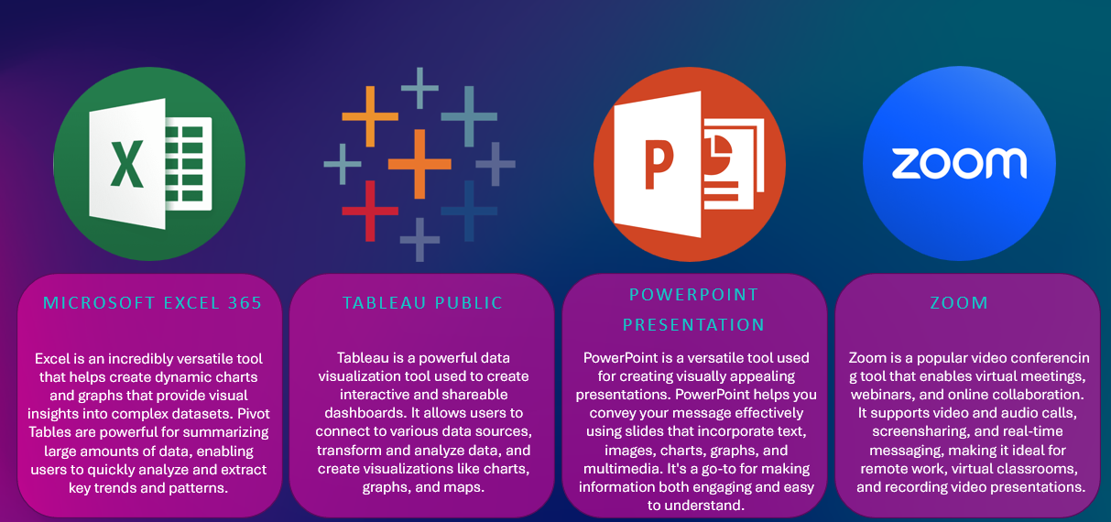
Tech-stack used

Slide 5
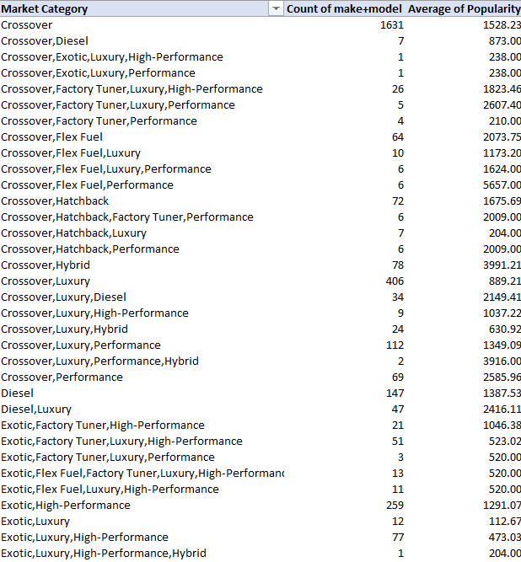
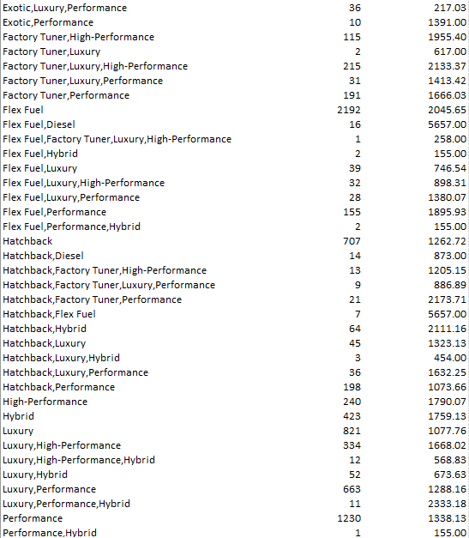
INSIGHT REQUIRED: How does the popularity of a car model vary across different market categories?
Task 1.A: Create a pivot table that shows the number of car models in each market category and their corresponding popularity scores.
Task 1.B: Create a combo chart that visualizes the relationship between market category and popularity.

Slide 6
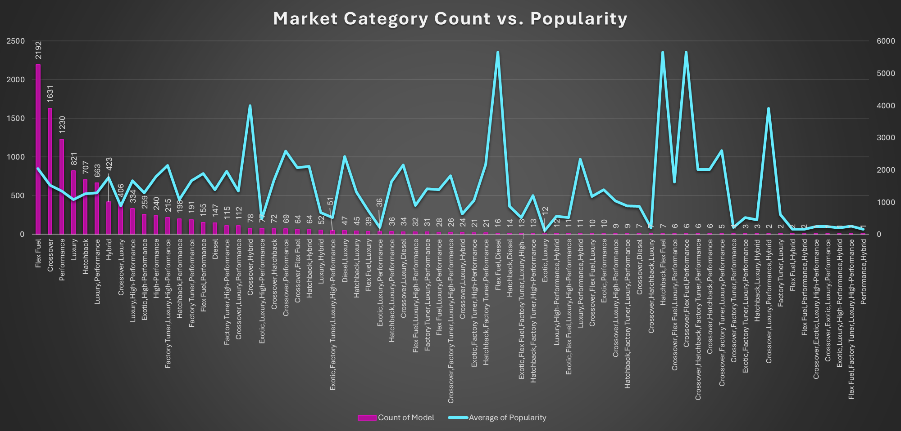

Slide 7
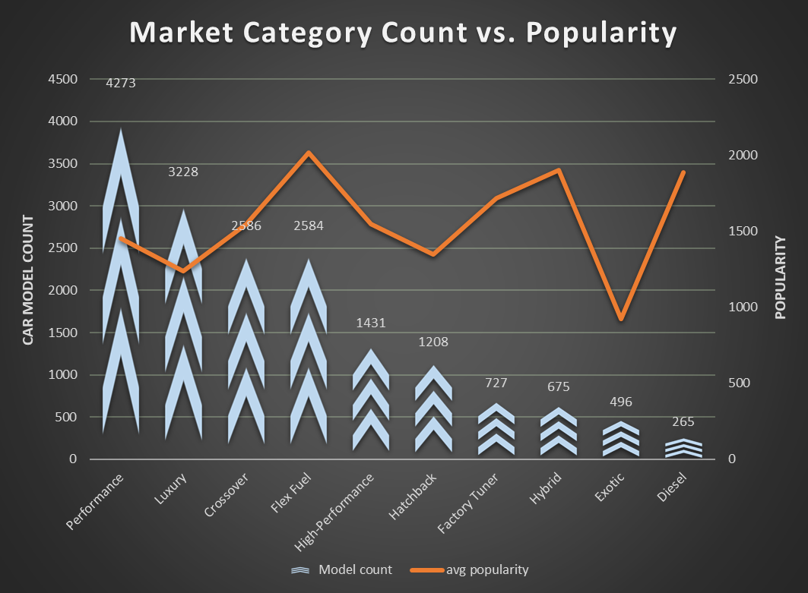
INSIGHTS
The 5 highest market categories in popularity overall are: 1) Flex Fuel, diesel 2) Hatchback, Flex Fuel 3) Crossover, Flex Fuel, Performance 4) Crossover, Luxury, Performance, Hybrid and 5) Crossover, Hybrid. Meanwhile the second chart with individual market categories shows that Flex Fuel, Diesel and Hybrid.
According to the first chart, overall, market categories with highest car model count are Flex Fuel, Crossover, Performance, Luxury and Hatchback. For the second chart its Luxury, Exotic, Hatchback and Crossover.
The overall market categories are popular because they cater to specific consumer needs, but they’re challenging for manufacturers to develop cost-effectively and meet demand with models that perform well in each area
For example, combining luxury, performance, and hybrid powertrains into a single crossover is complex and costly. Balancing weight, power, and high-end features requires substantial R&D, which can lead to higher production costs and prices.

Slide 8
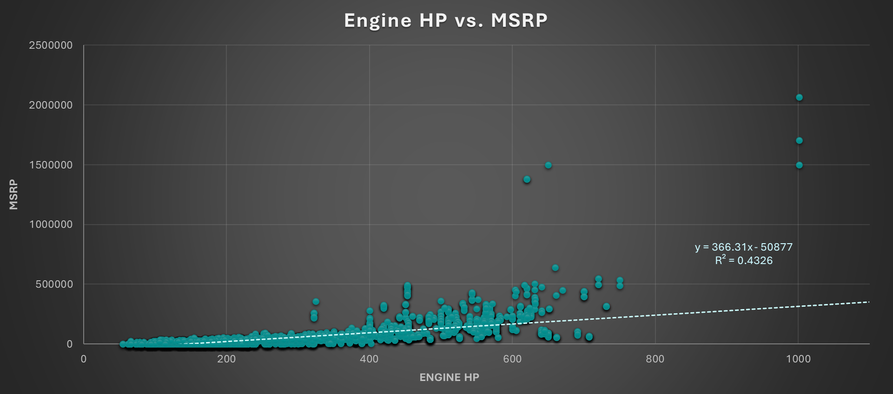
Insight Required: What is the relationship between a car's engine power and its price?
Task 2: Create a scatter chart that plots engine power on the x-axis and price on the y-axis. Add a trendline to the chart to visualize the relationship between these variables.

Slide 9

Insights
There is a positive correlation between engine horsepower (HP) and MSRP with the R² value = 0.4326 indicating a moderate correlation. As engine horsepower increases, the price of the vehicle generally tends to rise but not a lot, meaning that other factors besides horsepower (such as brand, luxury features, or build quality) also significantly affect MSRP.
Above 500 HP, MSRPs rise steeply, suggesting that higher horsepower models command premium prices due to luxury materials, advanced tech, and brand value. A few cars with extremely high horsepower (1000 HP or more) and high MSRP values exceeding $1,000,000 are likely exotic cars or supercars, which show that there are extreme performance cars.
Most of the data points are clustered between 100 HP to 400 HP, with MSRP values mainly between $0 to $200,000 covering mainstream vehicles like sedans, hatchbacks, and SUVs. For cars with horsepower below 200 HP, for lower-powered cars the MSRP seems to be relatively flat indicating engine HP doesn't drive price as much.
In summary, while HP does influence MSRP, the relationship is more significant for high-performance and luxury cars, whereas regular vehicles show a more consistent pricing structure regardless of slight HP variations.

Slide 10
Insight Required: Which car features are most important in determining a car's price?
Task 3: Use regression analysis to identify the variables that have the strongest relationship with a car's price. Then create a bar chart that shows the coefficient values for each variable to visualize their relative importance.

Slide 11
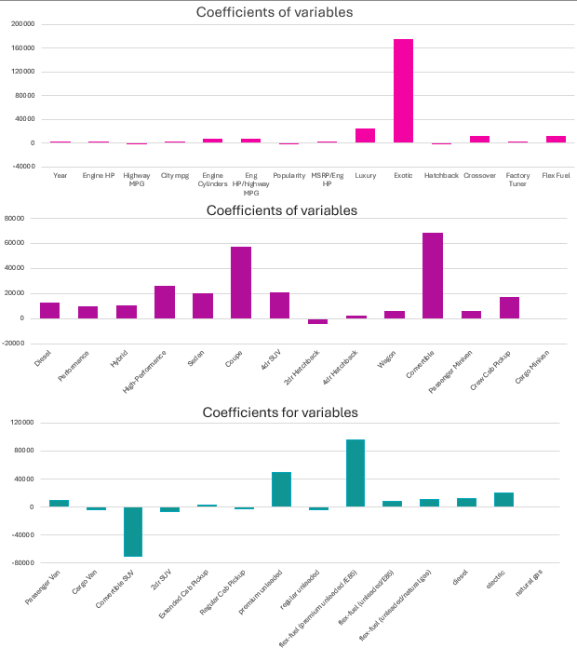
Insights
The analysis shows that Luxury and Exotic categories have the highest positive impact on car price, especially Exotic cars, highlighting a strong price premium. Key features with moderate positive effects include engine HP, highway MPG, engine cylinders, and market categories like crossover and flex-fuel.
Body styles such as Convertible, High-Performance, 4-door SUV, Sedan, and Coupe also contribute positively, while Hybrid, Performance, Wagon, Passenger Minivan, Crew Cab Pickup, and Diesel show moderate price premiums. Notably, Convertible SUVs have a significant negative impact on price.
Alternative Fuel categories have positive coefficients especially Flex-Fuel (premium unleaded/E85) and Premium unleaded as well as Electric cars, reflecting that hybrid or alternative fuel cars are generally priced higher, likely due to the added technology and fuel efficiency benefits.
This regression analysis suggests that luxury and exotic market segments, along with performance features like alternative fuel categories, high-engine power/horsepower models , are key drivers of higher car prices, while utility-focused vehicles like vans have a lower price association.

Slide 12
Insight Required: How does the average price of a car vary across different manufacturers?
Task 4.A: Create a pivot table that shows the average price of cars for each manufacturer.
Task 4.B: Create a bar chart or a horizontal stacked bar chart that visualizes the relationship between manufacturer and average price.

Slide 13
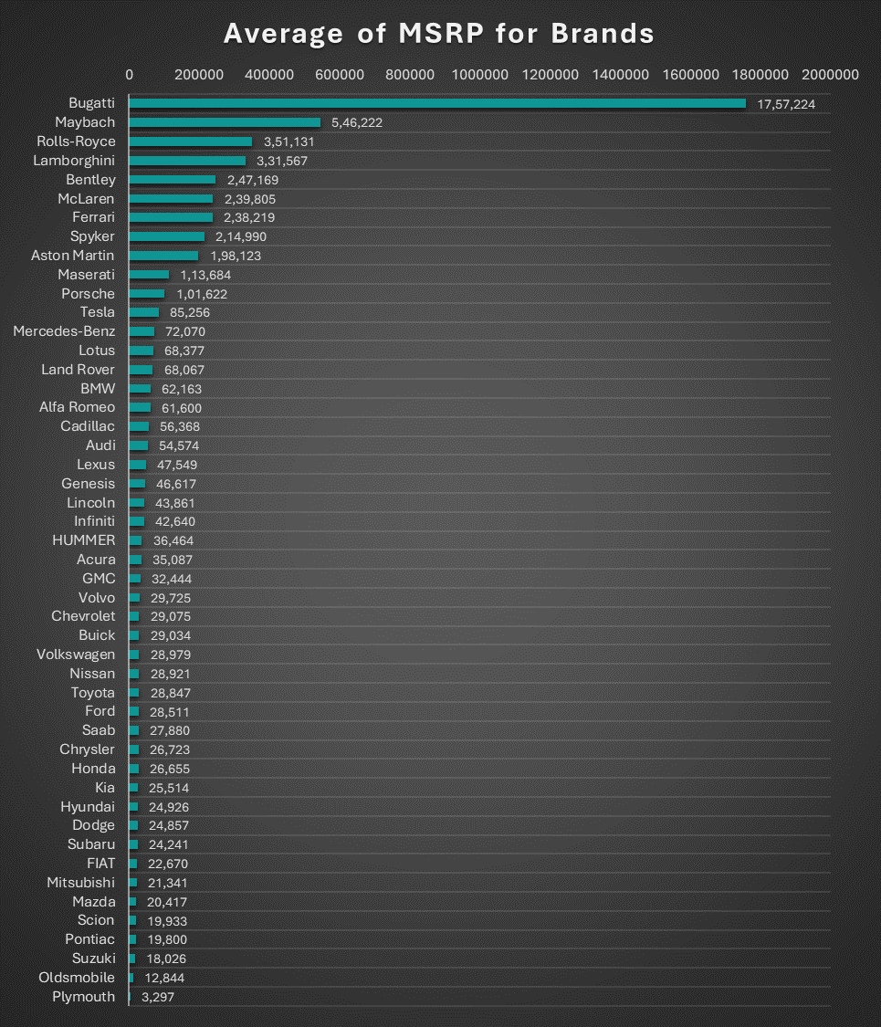
Insights
Top-Tier Luxury and Exotic Brands:
Bugatti has by far the highest average MSRP at over $1.7 million, reflecting its position as an ultra-luxury and high-performance brand. Maybach and Rolls-Royce follow, with average MSRPs around $546,000 and $351,000, respectively. Lamborghini, Bentley, McLaren, Ferrari, and Spyker also feature high average MSRPs, ranging from approximately $2.1 million for Spyker down to $331,000 for Lamborghini.
Luxury Brands:
Brands like Aston Martin, Maserati, Porsche, Tesla and Mercedes-Benz show high average MSRPs, typically between $70,000 and $200,000. This aligns with their luxury market positioning and reflects a strong customer demand for premium materials, performance, and brand prestige.
Mid-Range and Entry-Level Brands:
Brands like BMW, Land Rover, Audi, Cadillac, Lexus, and Volvo have more moderate average MSRPs, generally around $40,000 to $70,000. These brands provide a balance between luxury and affordability, catering to a wider audience
Mainstream and Budget Brands:
Mainstream brands such as Chevrolet, Ford, Toyota, Honda, Hyundai, Nissan, and Kia show lower average MSRPs, mostly under $30,000. These brands emphasize affordability and accessibility. Suzuki, Oldsmobile, and Plymouth have some of the lowest average MSRPs, which aligns with their reputation for economical and practical vehicles rather than premium or luxury options.

Slide 14
INSIGHT REQUIRED: What is the relationship between fuel efficiency and the number of cylinders in a car's engine?
Task 5.A: Create a scatter plot with the number of cylinders on the x-axis and highway MPG on the y-axis. Then create a trendline on the scatter plot to visually estimate the slope of the relationship and assess its significance.
Task 5.B: Calculate the correlation coefficient between the number of cylinders and highway MPG to quantify the strength and direction of the relationship.

Slide 15
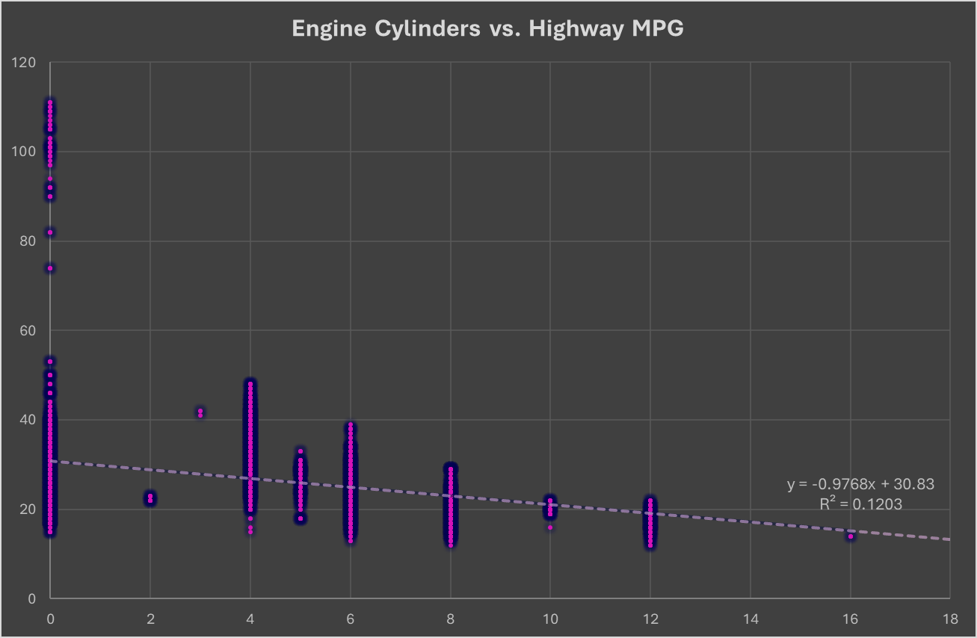
Insights
The trend line has a slight negative slope, indicating a weak negative correlation between the number of engine cylinders and highway miles per gallon (MPG). This suggests that vehicles with more cylinders tend to have slightly lower fuel efficiency on highways. Low R-Squared Value: The R² value is 0.1203, which is quite low. This indicates that the number of cylinders explains only about 12% of the variability in highway MPG. Therefore, other factors (such as vehicle weight, aerodynamics, or engine type) likely play a much larger role in determining highway MPG.

Slide 16

Building the dashboard

Slide 17
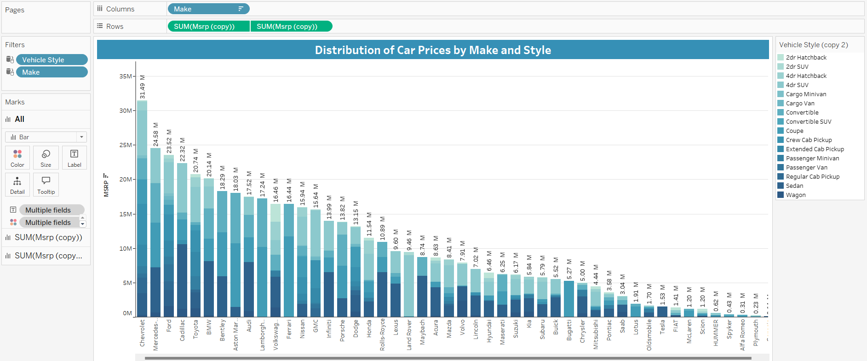
Task 1: How does the distribution of car prices vary by brand and body style?

Slide 18
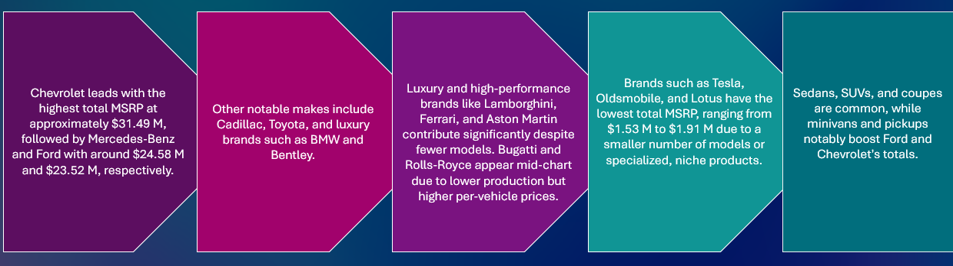
insights
This dashboard displays the distribution of car prices according to different variables by car make and vehicle style. Most of the higher total MSRPs are associated with well-established mainstream and luxury car brands as they show significant variation in their vehicle styles.

Slide 19
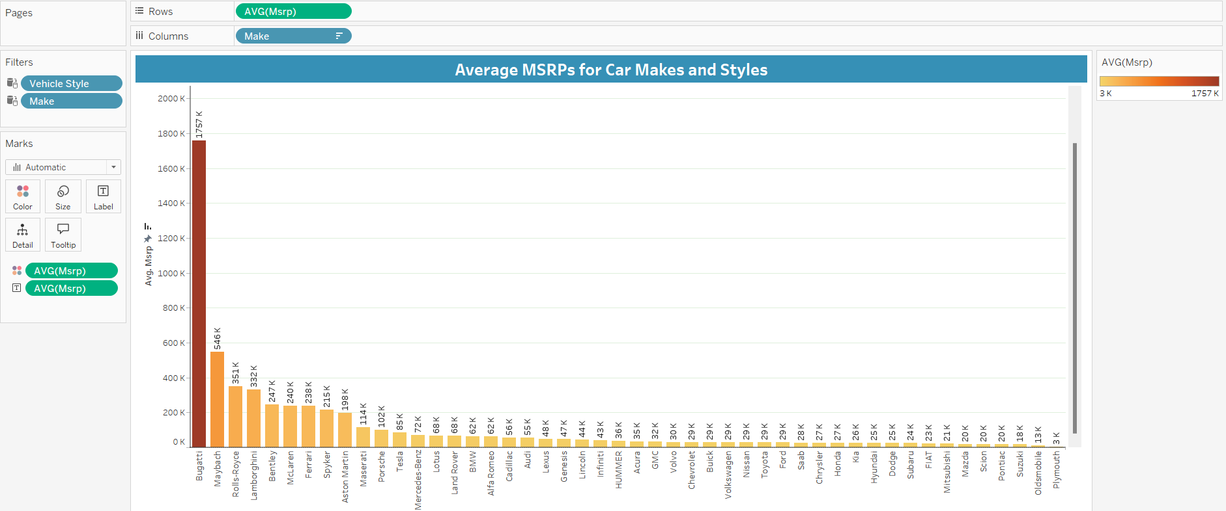
Task 2: Which car brands have the highest and lowest average MSRPs, and how does this vary by body style?

Slide 20
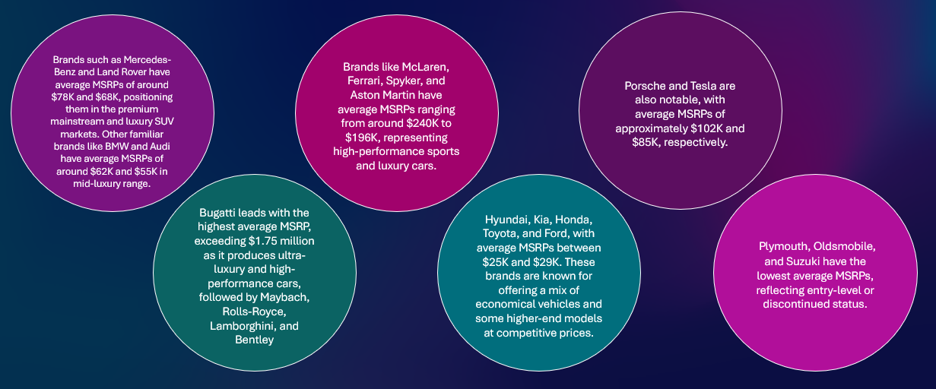
insights
This chart highlights average MSRPs for car brands, showing their market position from ultra-luxury to budget-friendly :

Slide 21
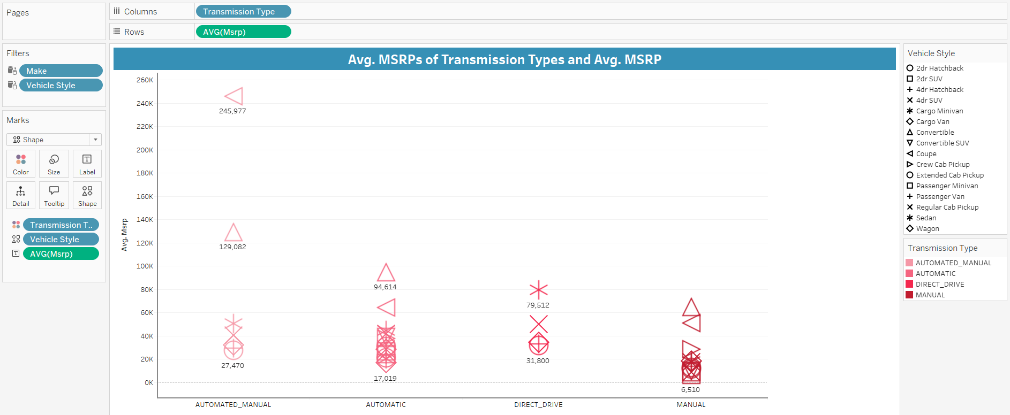
Task 3: How do the different feature such as transmission type affect the MSRP, and how does this vary by body style?

Slide 22
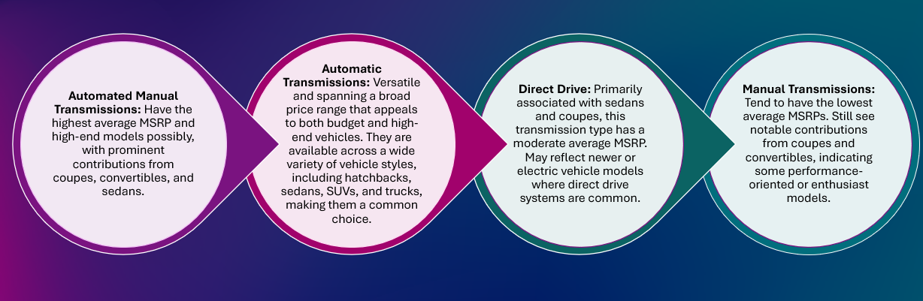
insights
This chart displays the average MSRPs for different transmission types across various vehicle styles. Here are some key insights:

Slide 23
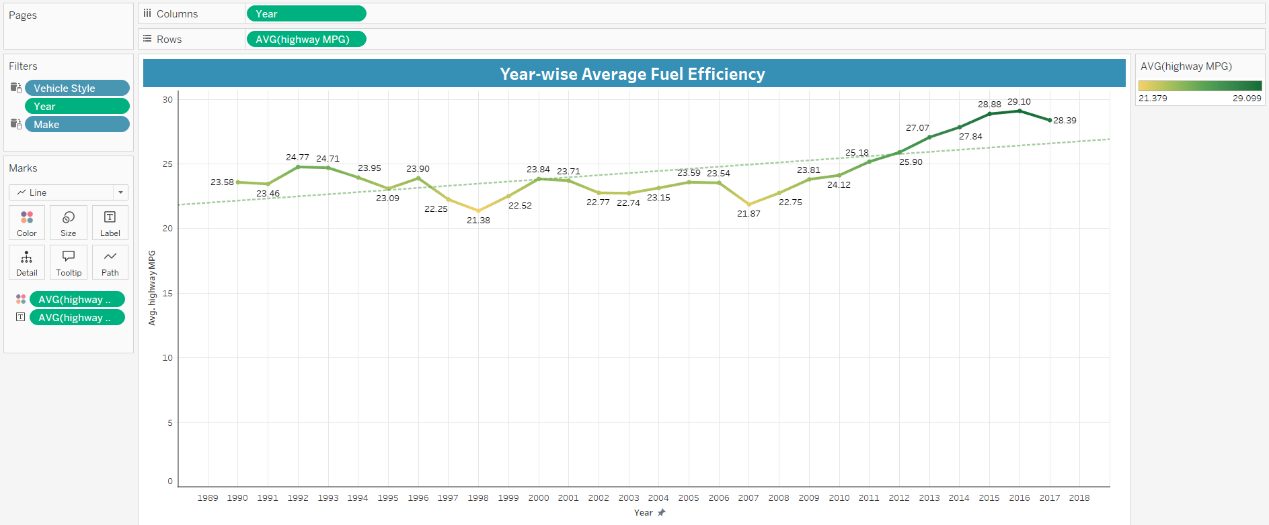
Task 4: How does the fuel efficiency of cars vary across different body styles and model years?

Slide 24
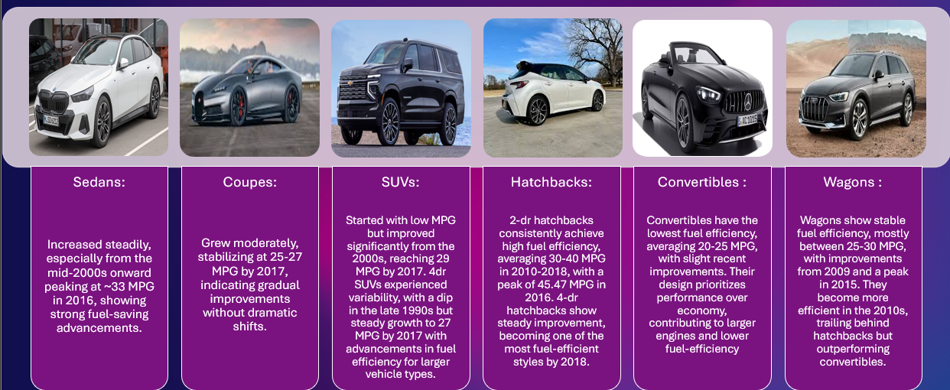
insights
From the late 1980s to 2017, fuel efficiency improved for all vehicle types, despite some fluctuations in the mid-1990s and early 2000s. Hatchbacks and sedans remained the most fuel-efficient, with 2dr SUVs showing major gains narrowing the gap with sedans and 4dr SUVs.

Slide 25
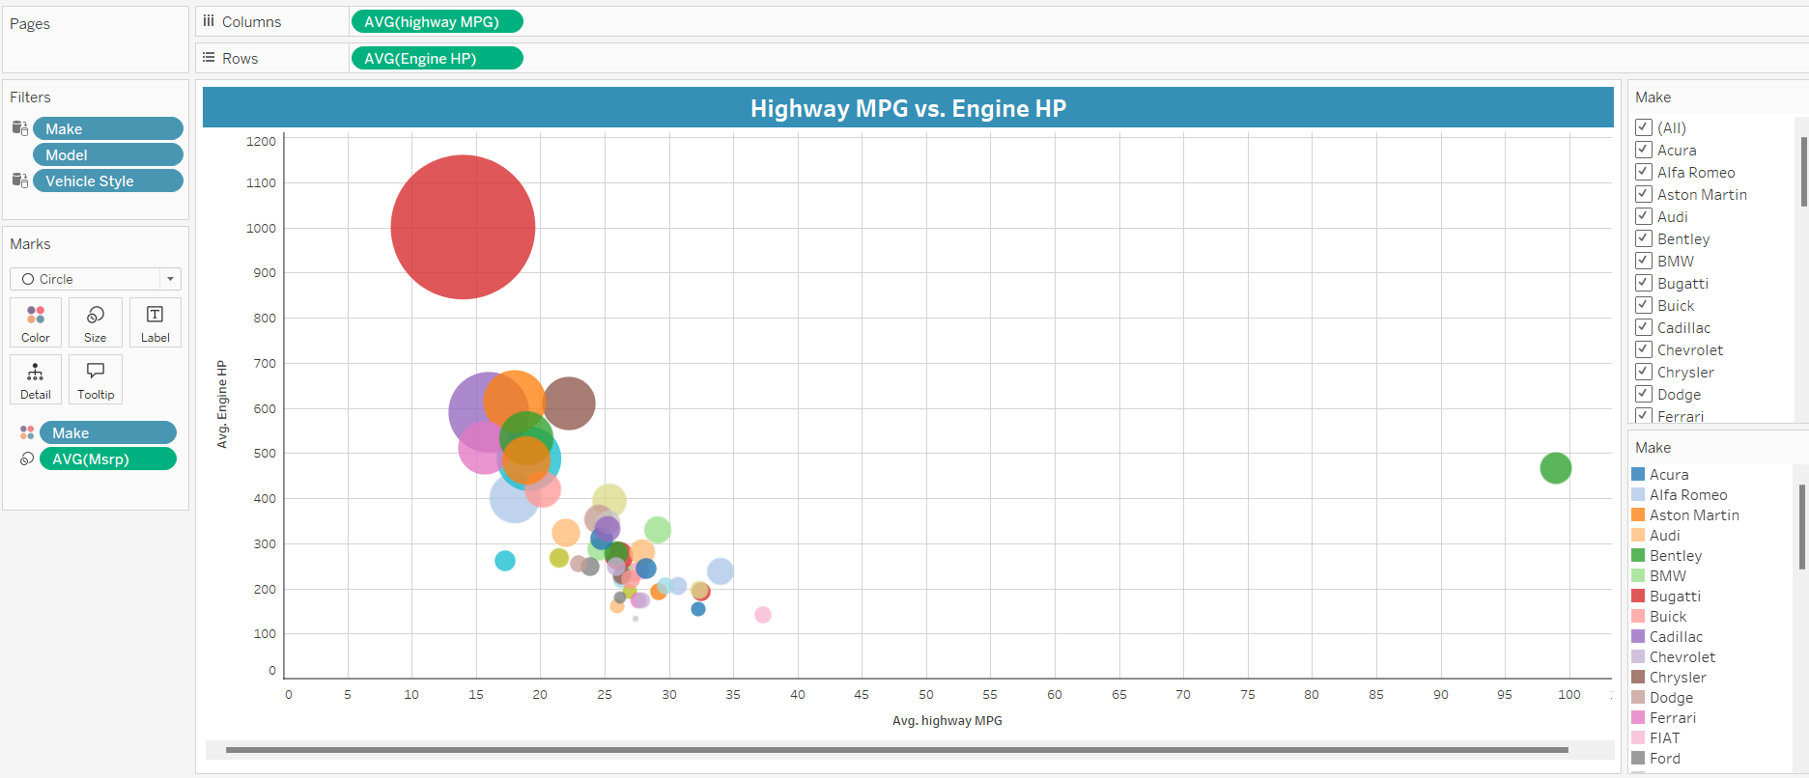
Task 5: How does the car's horsepower, MPG, and price vary across different Brands?

Slide 26
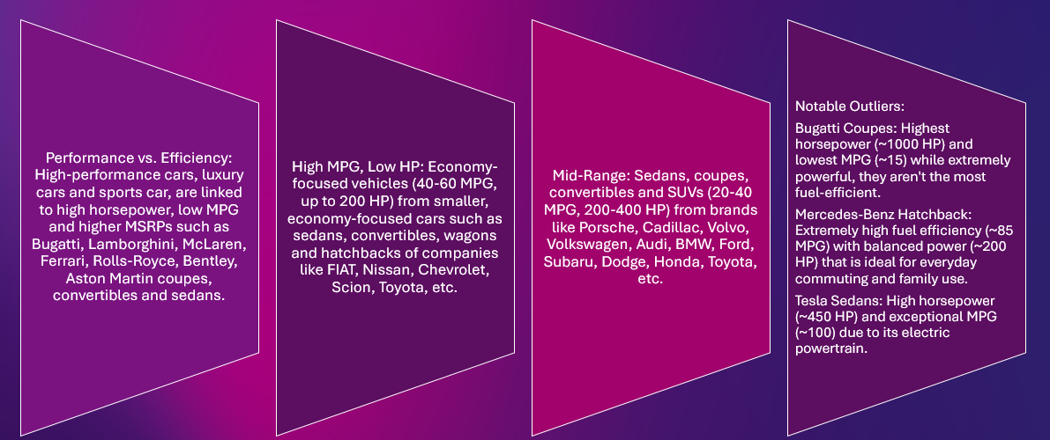
insights
This scatter plot highlights the relationship between highway MPG, engine horsepower, and MSRP across various car brands and types:

Slide 27
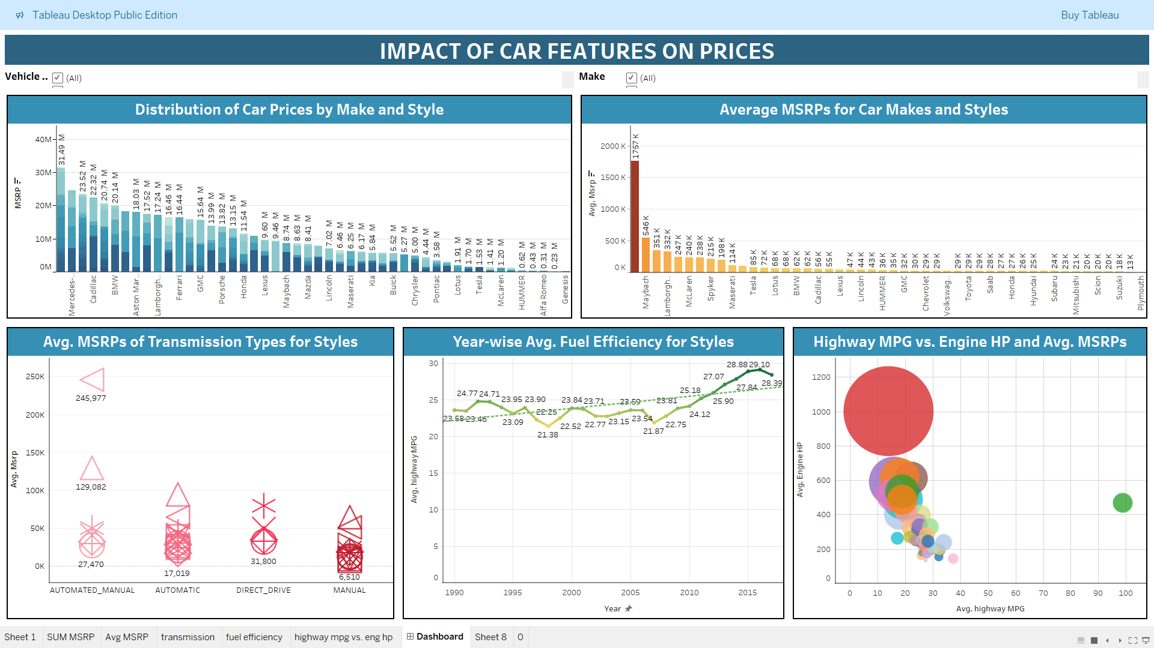

Slide 28
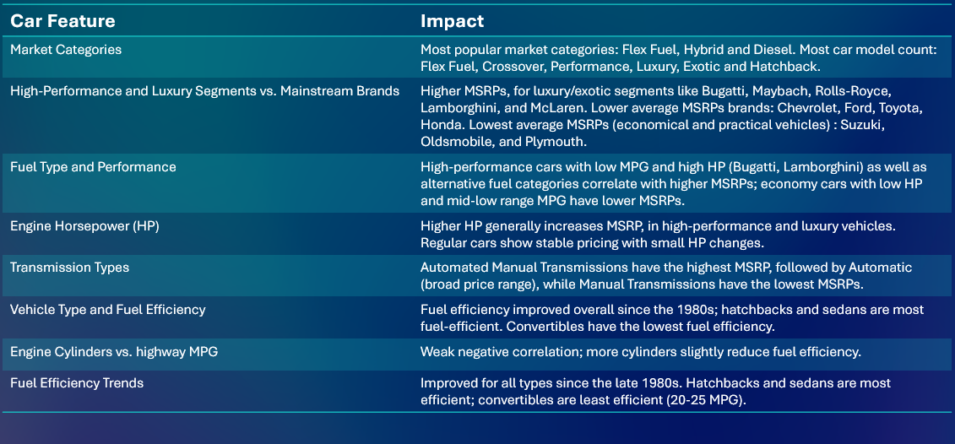
results

Slide 29

Thank you
Shreya Gunjal
​

